Slide 1










Since
2025
STUDBUD
Study Buddy

Slide 2
Since
2025
STUDBUD
Study Buddy
Study Buddy
Presented By:
CS3B
Asuncion, Irish Aliyah
Since
2025
Buhain, Ash Jecel
Janda, Sean Angelo
STUDBUD
Lontoc, Max Alfred
Study Buddy
Santiago, Rainjustine
Santulan, Jal Joven

Slide 3
Since
2025
STUDBUD
Study Buddy

Slide 4
Since
2025
STUDBUD
Study Buddy
System Design for Study Buddy
Designing a Study Buddy involves creating a solution for studying, resources sharing and also to connect peers for improving academic performance. Study Buddy is not only to provide resources and to find a tutor for the IT/CS students but also to improve the users experience in a sense of cooperative learning.

Slide 5
Since
2025
STUDBUD
Project Overview
Study Buddy
Purpose: Study Buddy is a web-based solution designed for resource sharing and peer-to-peer connection to improve academic performance.
Cooperative Learning: Beyond just a repository, it facilitates an environment for cooperative learning among students.
Target Audience: Specifically designed for IT and CS students at Cavite State University – Cavite City Campus.

Slide 6
Since
2025
STUDBUD
Study Buddy
System Requirements & Design Standards
Functional Features: Includes user registration, the ability to upload/download reviewers, and integrated chatrooms.
Search Capability: Allows students to search for specific tutors and categorized reviewers.
Non-Functional Standards: Prioritizes a simple, clean UI, mobile-friendly responsive design, and secure data handling managed by an Admin.

Slide 7
Since
2025
System Actors and Workflow
STUDBUD
Study Buddy
IT/CS Students: Primary users who search for tutors, use chatrooms, and add reviewers.
Student Tutors: Responsible for teaching specialized subjects, accepting users, and providing academic materials.
Admin: The system moderator responsible for approving resources, monitoring messages, and managing user accounts to ensure a safe environment.
System Workflow: The workflow follows a logical path from Account Creation and Login Verification to a centralized Dashboard for navigation.

Slide 8
Since
2025
STUDBUD
Study Buddy
Capacity and Performance Estimation
Concurrency: The system is architected to support 50 to 100 concurrent users performing tasks like uploading resources.
Storage Metrics: Total storage is calculated at 2.6 GB.
Resources: 2.5 GB allocated for 500 PDF reviewers (approx. 5MB each).
User Data: 0.1 GB allocated for member profiles and accounts.

Slide 9
Since
2025
Architecture & Data Layer
STUDBUD
Study Buddy
Front-end: HTML, CSS, and JavaScript for a responsive interface.
Back-end: VB.NET and Visual Studio frameworks (ASP.NET) for application logic.
Nugget Packages: Signal R is used to facilitate real – time messaging in group and private chatrooms.
Owin acts as the middleware to manage these persistent connections efficiently.
Framework Support (Microsoft.AspNetCore) provides the modern architectural foundation for handling web requests, role – based access control and remains responsive and secure for the users.
MySQL.Data is for data connectivity.
Database Management: Powered by phpMyAdmin (XAMPP) to handle CRUD (Create, Read, Update, Delete) operations.
Data Structure: Organized into specific tables including RESOURCES, USER, FRIENDREQUEST, CHATROOMS, etc; to maintain data integrity.

Slide 10
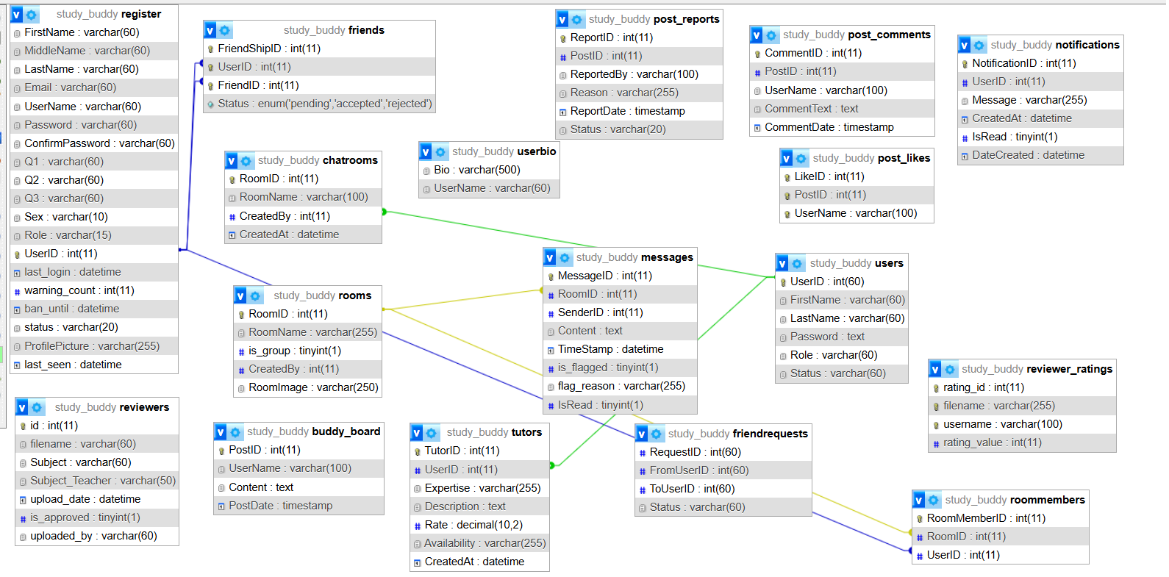
Since
2025
UML (Unified Modelling Language)
STUDBUD
Study Buddy

Slide 11
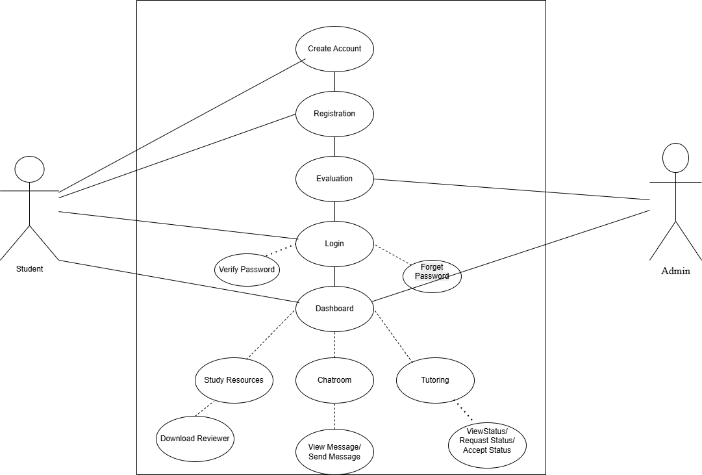
USE CASE
Since
2025
STUDBUD
Study Buddy

Slide 12
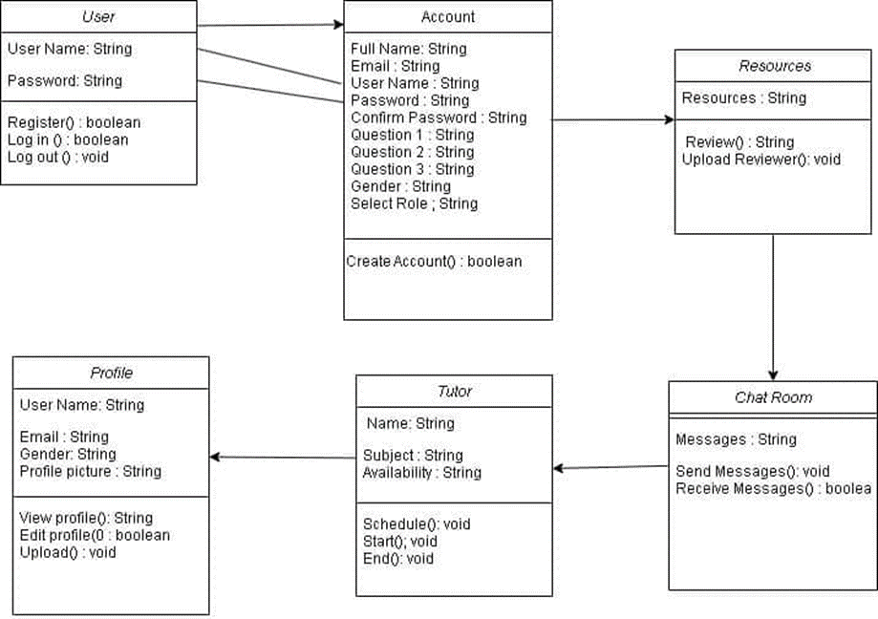
ER DIAGRAM
Since
2025
STUDBUD
Study Buddy

Slide 13
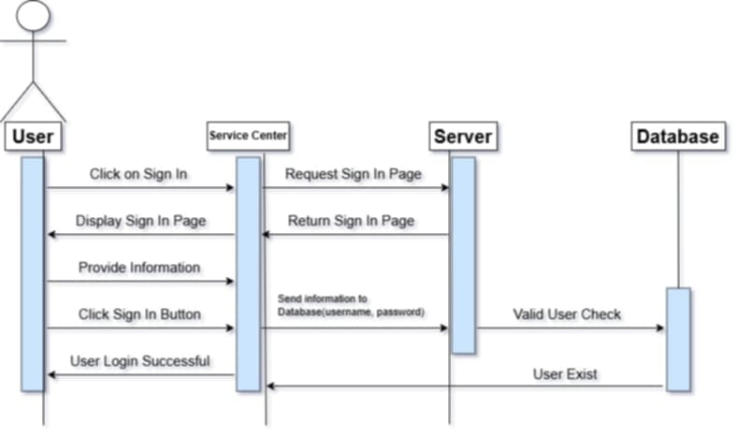
Sequence Diagram
Since
2025
STUDBUD
Study Buddy

Slide 14
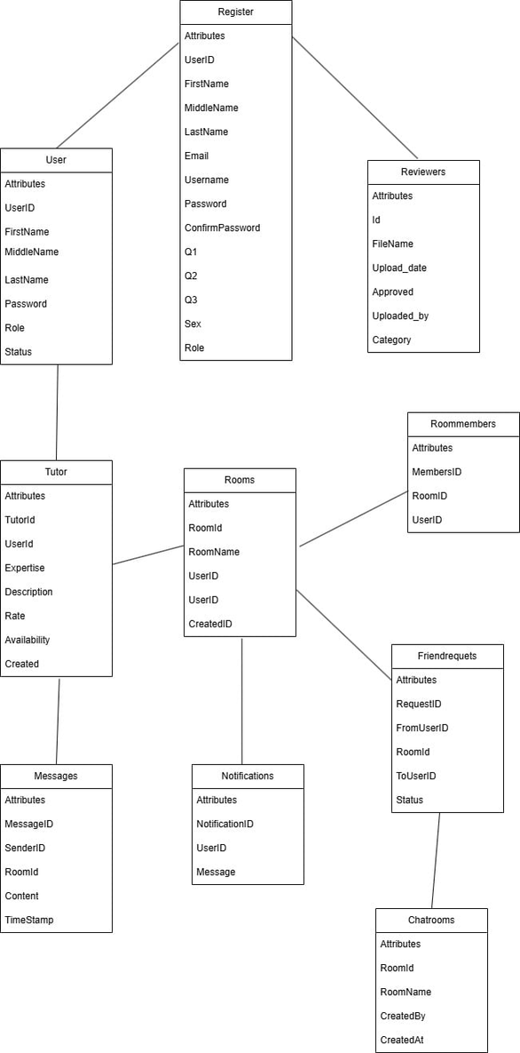
Since
2025
STUDBUD
Study Buddy
Definition
of
Modules

Slide 15

Since
2025
STUDBUD
Study Buddy
Flow Chart

Slide 16
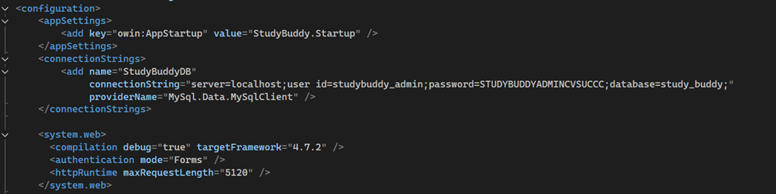
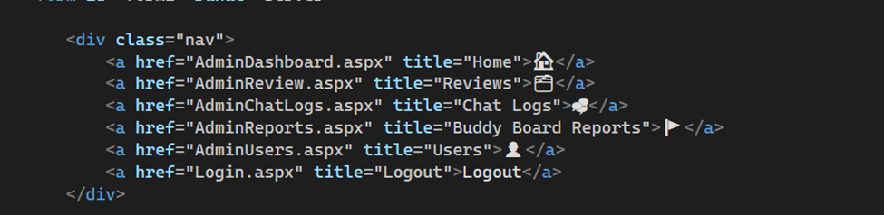
Code Snippet 1
Since
2025
STUDBUD
Study Buddy
Code Snippet 2.0

Slide 17
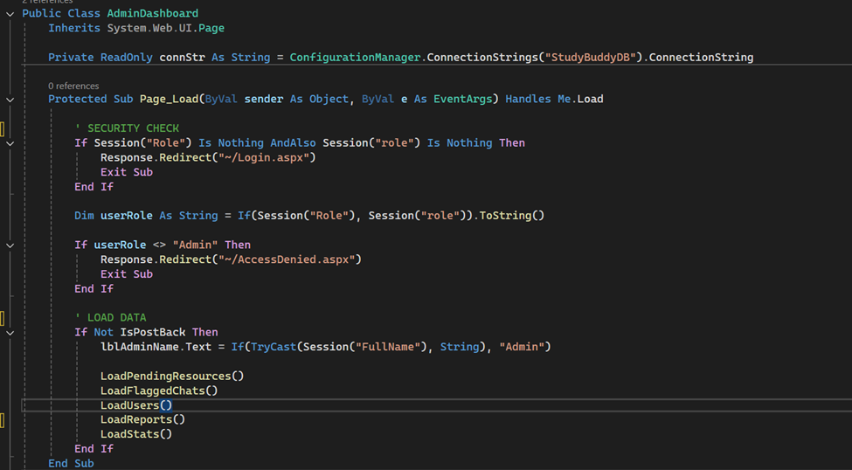
Code Snippet 2.1
Since
2025
STUDBUD
Study Buddy

Slide 18
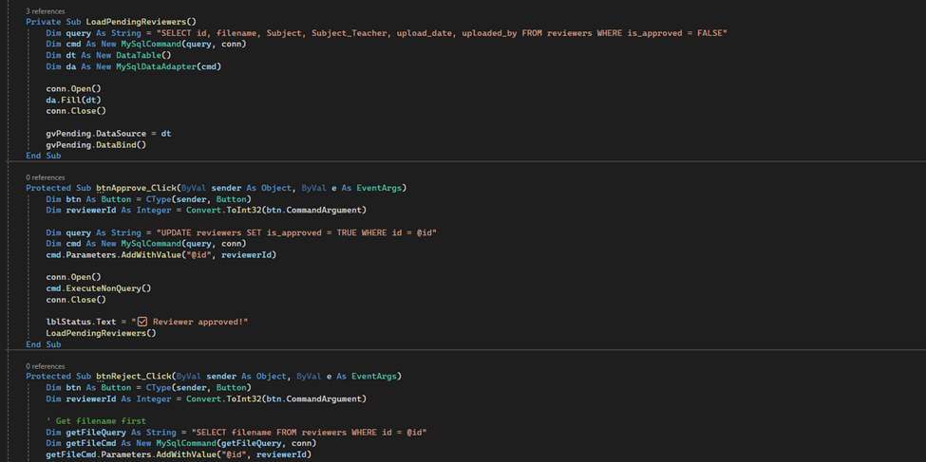
Code Snippet 3
Since
2025
STUDBUD
Study Buddy

Slide 19
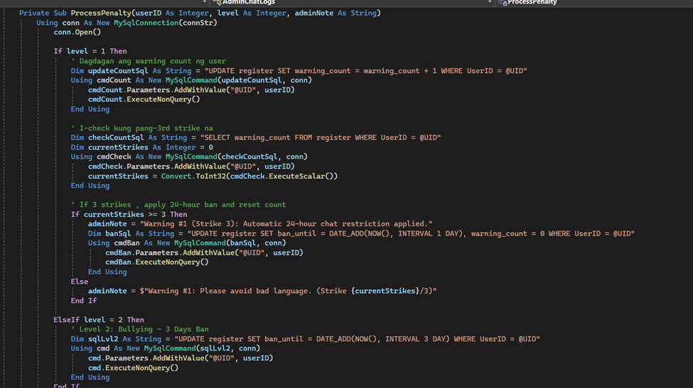
Code Snippet 4
Since
2025
STUDBUD
Study Buddy

Slide 20
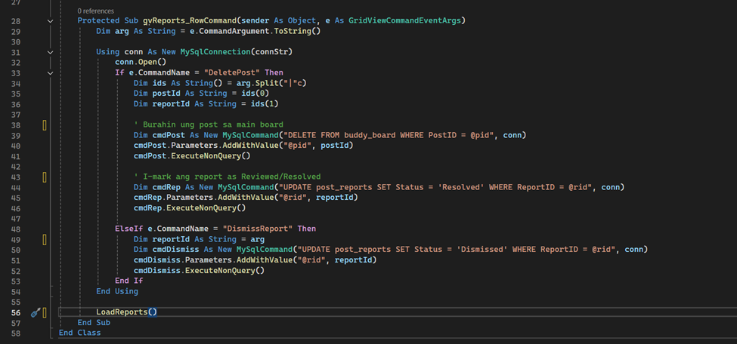
Code Snippet 5
Since
2025
STUDBUD
Study Buddy

Slide 21
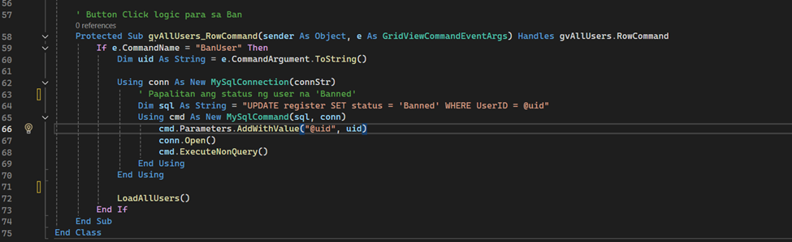
Since
2025
STUDBUD
Study Buddy
Code Snippet 6

Slide 22
T
H
A
N
K
Y
O
U
Since
2025
STUDBUD
Study Buddy

